Slide 1
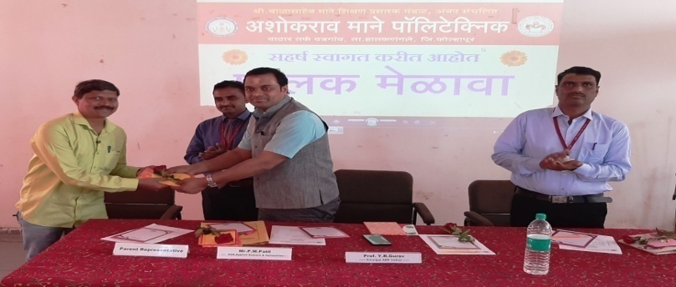
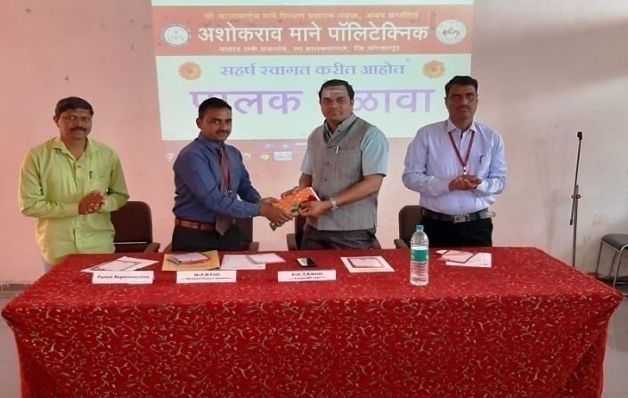
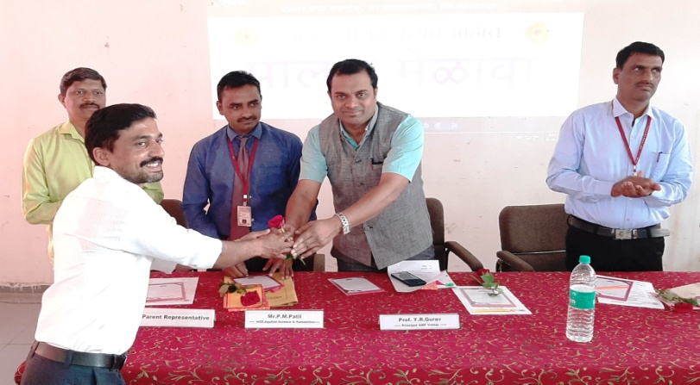
SBMSPMA
ASHOKRAO MANE POLYTECHNIC
VATHAR TARF VADGAON
Parents Meet@ Department of Applied Science and Humanities – 15th Feb 2020
Ashokrao Mane Group

Slide 2
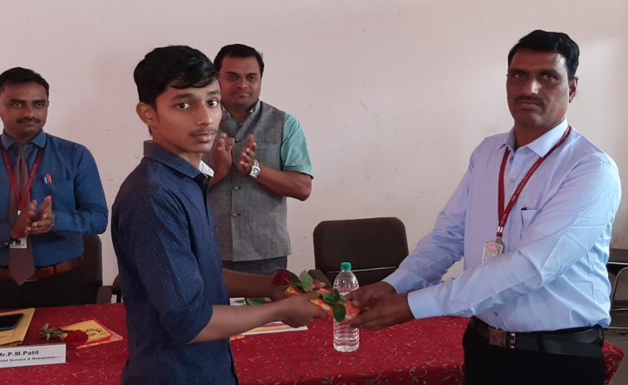
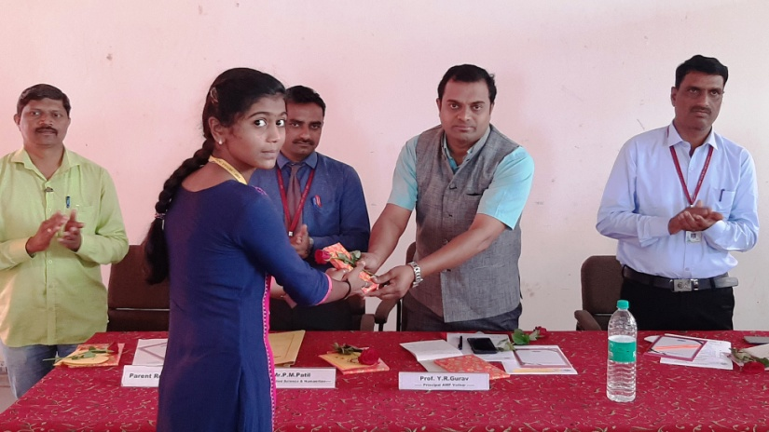
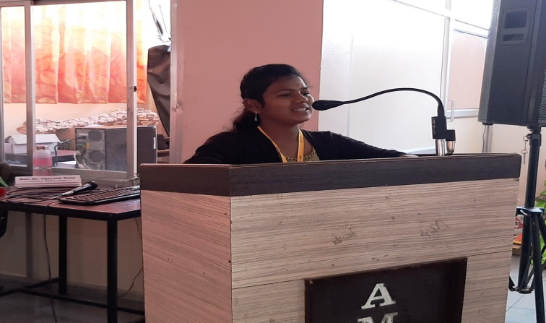
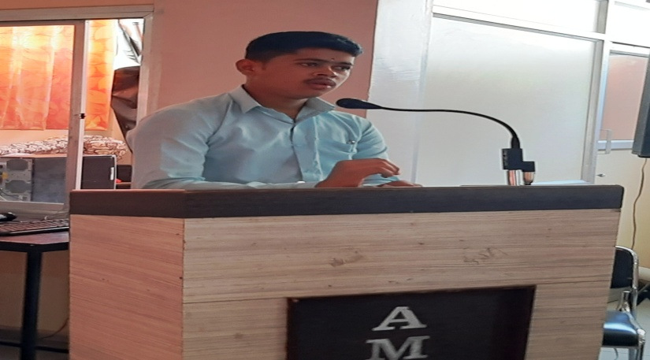
SBMSPMA
ASHOKRAO MANE POLYTECHNIC
VATHAR TARF VADGAON
Parents Meet@ Department of Applied Science and Humanities – 15th Feb 2020
Ashokrao Mane Group

Slide 3
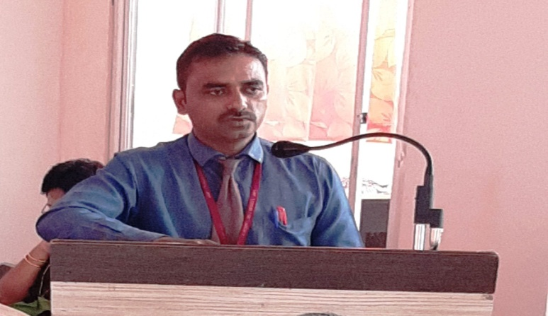
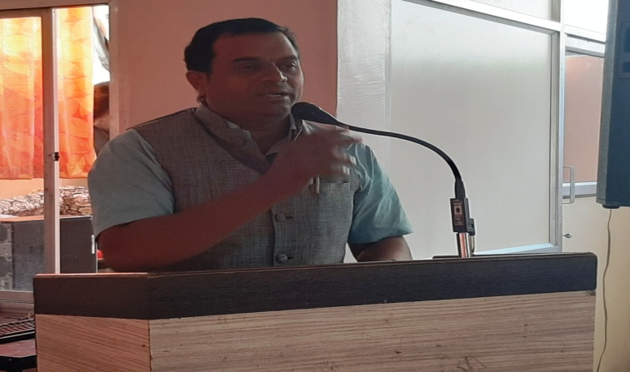
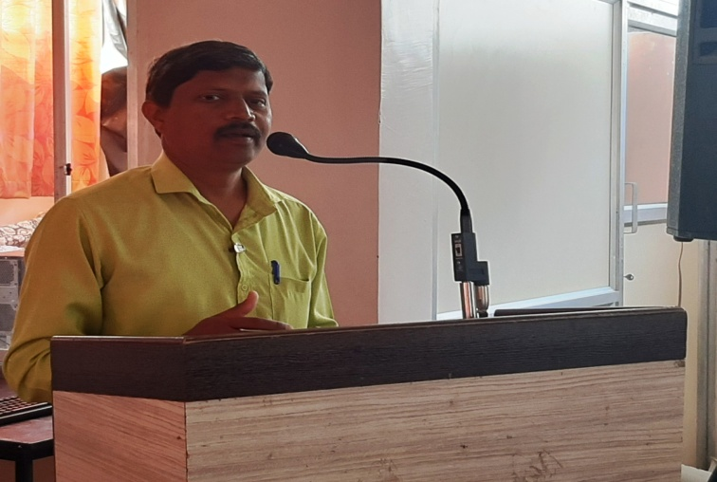
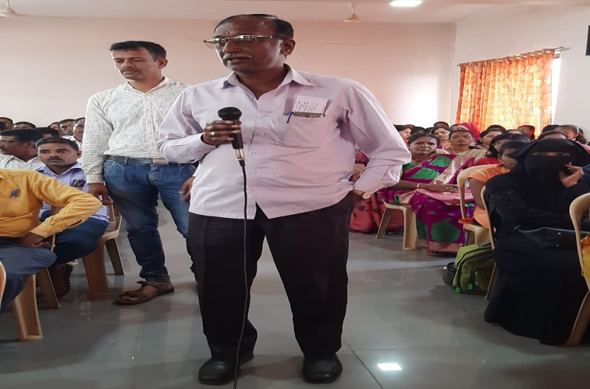
SBMSPMA
ASHOKRAO MANE POLYTECHNIC
VATHAR TARF VADGAON
Parents Meet@ Department of Applied Science and Humanities – 15th Feb 2020
Ashokrao Mane Group

